Slide 1


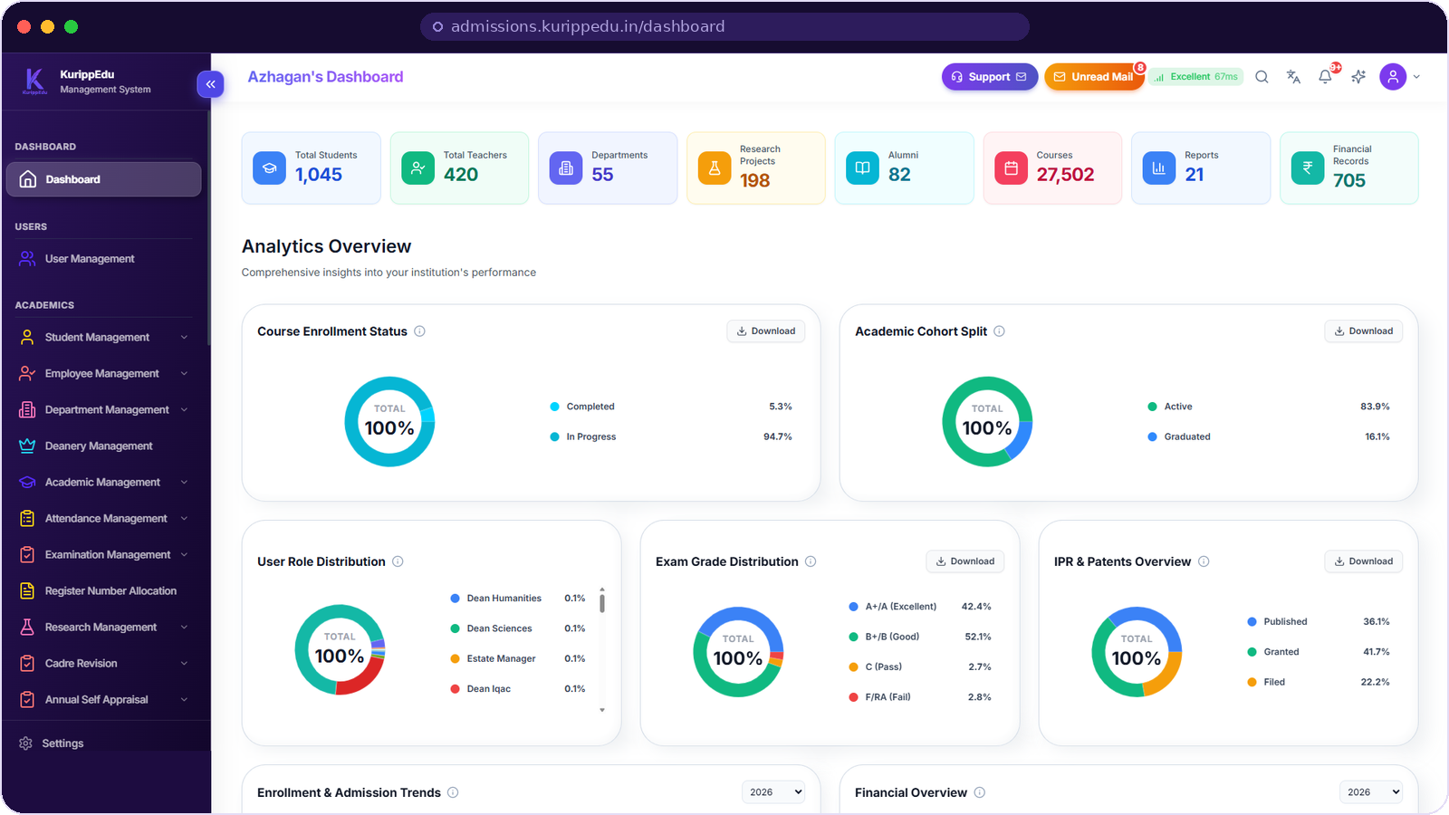
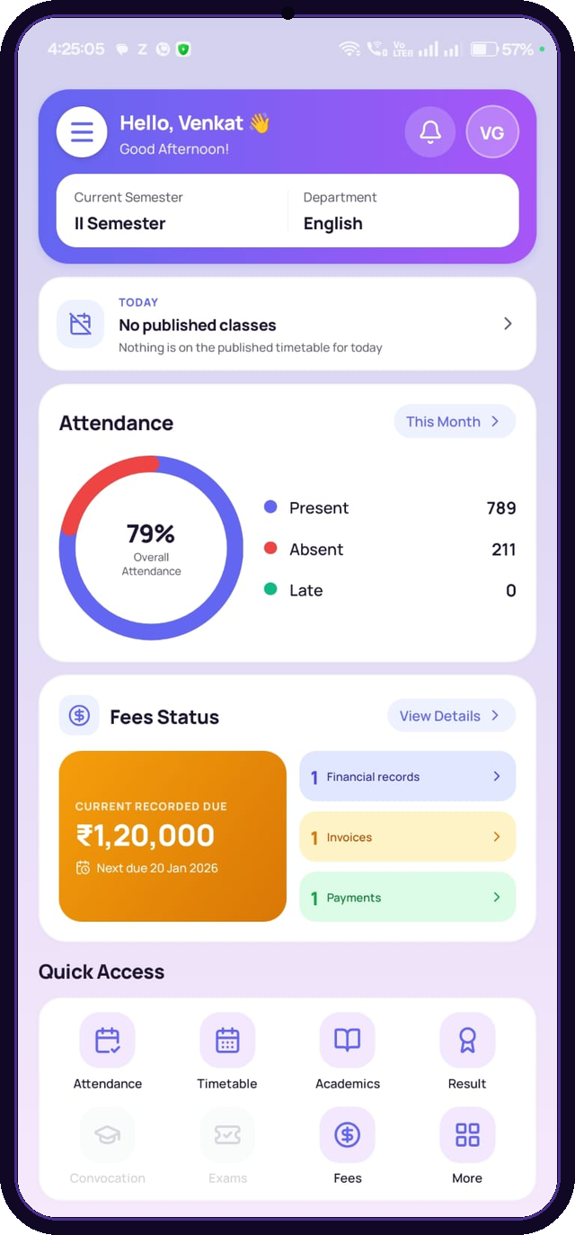
Educational Suite™
Run your entire
institution from
one login.
One ERP for admissions, academics, examinations, research, quality, finance and communication — plus a student and parent app in every pocket.
46+ modules
Web + mobile app
Version 2026.06
kurippedu.in
A FiveAngstrom Product
Notes:
Open: "KurippEdu is one system that runs the whole institution — not a bundle of tools that email each other."
Anchor the three proof points: 46+ modules included, web plus a student/parent app, and a current release (2026.06) that we update.
Ask early: "How many separate systems or registers does your office use today?" — their number becomes the spine of this pitch.

Slide 2







THE PROBLEM
Most campuses don't have a software problem.
They have a seam problem.
What the seams actually cost
The same data, many times
Modules that don't talk
Faculty time spent on data entry instead of teaching
A student record retyped into admission, exam, library and fee registers — each copy ageing differently.
Attendance in one tool, marks in another, fees in a third. Nothing reconciles without a person in the middle.
Management decisions taken on stale, hand-assembled reports
Students and parents phoning the office for facts they should self-serve
Audit questions that nobody can answer from a single screen
Accreditation as a scramble
No single source of truth
Every NAAC or NIRF cycle turns into a months-long hunt for evidence that already exists somewhere.
Two departments, two numbers, and no way to tell management which one to trust.
None of this is a people problem. It's an architecture problem.
2
Notes:
Do not sell features here — sell recognition. Read the four cards and pause after each one.
The dark panel is the money slide for a principal or secretary: cost is measured in faculty hours and in decisions made on bad data.
Close with the last line verbatim: "It is not a people problem, it is an architecture problem." That reframes the purchase from software to structure.

Slide 3



WHY NOW
The difference is not the feature list.
It is whether everything shares one spine.
Campus today
With KurippEdu
Separate login for every office
One login, role-aware for every user
Spreadsheets emailed between departments
One database that every module reads and writes
Exam workflow tracked on paper and WhatsApp
Nine-stage exam pipeline with gated approvals
Appraisal scores computed by hand
Weighted scoring computed the same way every time
Reports assembled the week before a deadline
Accreditation evidence live, all year round
Students queue at the office counter
Students and parents self-serve on the app
3
Notes:
Walk the pairs across, not down: read the left line, then its replacement on the right. Six beats, ten seconds each.
If they push back with "we already have software for that" — agree, then point at the spine: the question is whether those systems write to the same record.

Slide 4




THE PLATFORM
One suite. Every department. One record of truth.
KurippEdu is a browser-based ERP for higher education. Admissions, academics, attendance, examinations, research, quality assurance, finance, stores, library and communication run as modules over a single database — with role-based access for administration, faculty, deans, students and parents.
46+
1
9
20+
modules, all included
database behind every screen
stages in the exam pipeline
department activity registers
Live counters from a KurippEdu demonstration instance — every tile is a module writing to the same database.
4
Notes:
This is the definition slide. Say it in one breath: browser-based ERP, one database, role-based access.
Use the four numbers as the shape of the product, then point at the strip of counters and note that each tile is a different module reading the same data.
Be explicit that the figures are from a demonstration instance — never present them as another college's results.

Slide 5

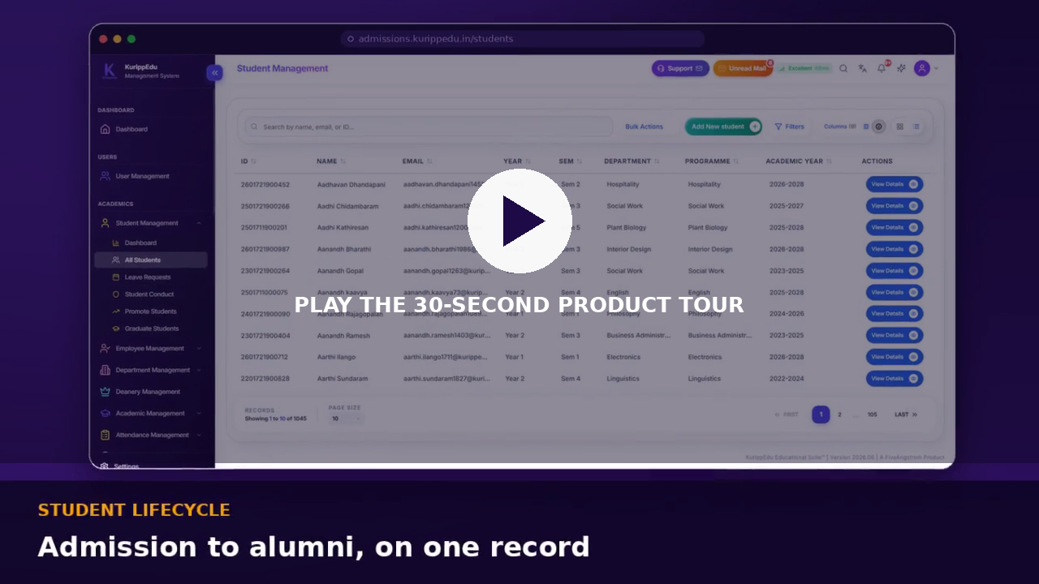

30-SECOND TOUR
See the whole thing before you ask a single question.
Ten screens in one continuous take: the command centre, students, faculty, academics, examinations, research, quality, communication and the mobile app.
Press Slide Show — the reel plays on its own.
No sound — talk over it.
kurippedu.in
Notes:
Hit F5 / Slide Show and let the reel run. It is 27 seconds and silent by design so you can narrate.
Narrate over it in this order: one dashboard, then the record modules, then examinations, then quality, then the phone.
If the video does not play, the same screens follow one by one from the next slide — keep going, do not troubleshoot in front of the customer.

Slide 6





PLATFORM MAP
46+ modules, in six families.
Nothing here is an add-on tier. A college that switches on KurippEdu switches on all of it.
People & access
Academics
Examinations
User management · Students · Employees · Register number allocation · Roles & streams · Parent logins
Academic management · Courses · Timetable · Calendar · Attendance · Subject master & selection · Internships · Drive
Exam sessions · Eligibility & registration · Venues, halls & seating · Hall tickets · Valuation & masking · ICA marks · Results
Research & quality
Operations
Community & comms
Projects · Publications · Milestones · Work logs · IPR & patents · IQAC · NIRF · Cadre revision · Self appraisal
Finance · Payroll · Stock & inventory · Stores & procurement · Library · Estate management · Roomwise details · Reports
Mail · Chat · Announcements · Notifications · Support desk · IIC · Extension activities · Alumni development office
Deanery management, department activities, admissions, data upload and reporting cut across all six families.
6
Notes:
Let them read for a moment — this slide is deliberately dense, because density is the argument.
Then say the line that closes procurement objections: "There is no module-by-module upsell. A working campus is the base product."
Ask which family they want to go deep on and jump straight to that slide — the rest of the deck is ordered but not linear.

Slide 7
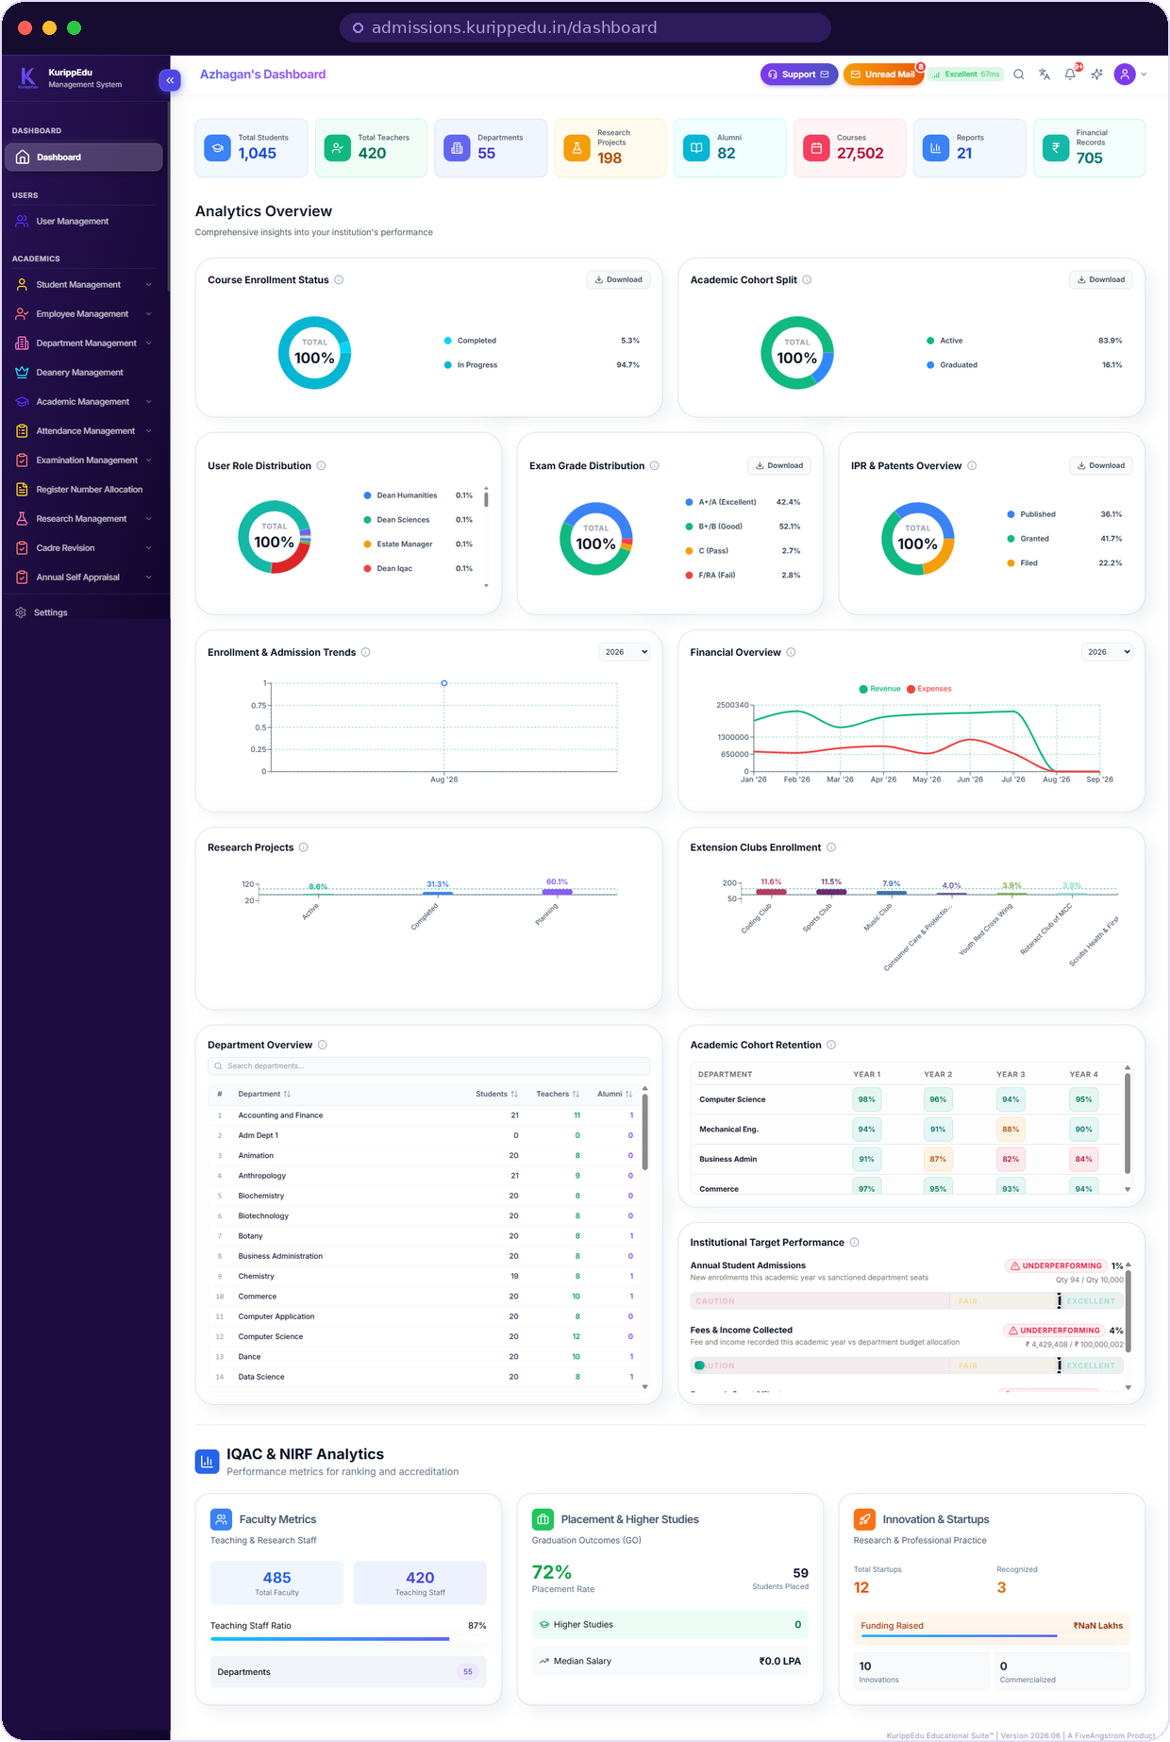




COMMAND CENTRE
The morning view a principal actually needs.
Eight live counters
Students, teachers, departments, research projects, alumni, courses, reports and financial records — refreshed from source.
Distribution at a glance
Enrollment status, cohort split, user roles, exam grades and IPR, each downloadable as its own dataset.
Trends by academic year
Admission and enrollment movement alongside revenue against expenses, month by month.
Targets, and honest flags
Admissions and fee collection scored against sanctioned seats and budget — underperformance is labelled, not buried.
Screens throughout this deck are captured from a live KurippEdu demonstration instance.
7
Notes:
This is the slide the head of the institution buys. Everything else serves it.
The scroll on the right is one page — say that out loud. It is not a report someone compiled; it is the landing screen.
Land on target performance: the system is willing to tell management that admissions are behind. That is what makes the rest of the numbers trustworthy.

Slide 8
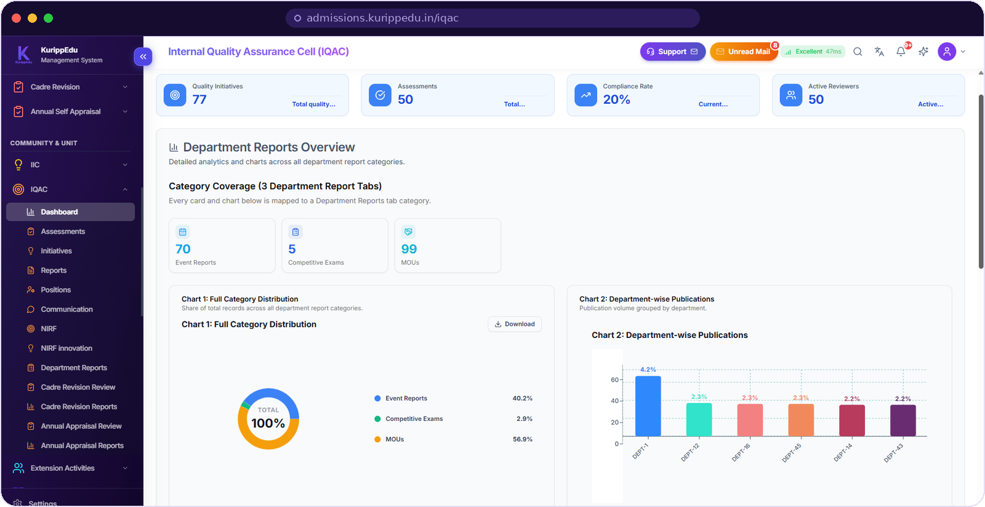


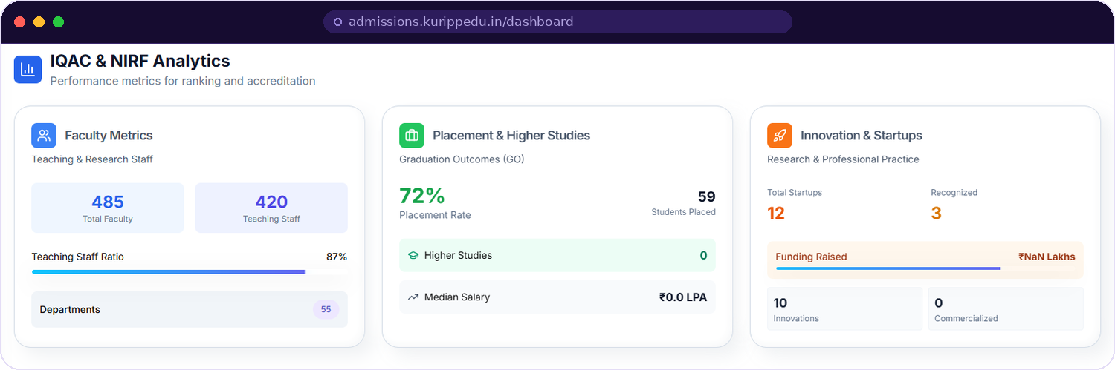
IQAC · NAAC · NIRF
Accreditation stops being a project.
Because evidence is captured where the work happens, the quality cell reads a dashboard instead of chasing departments.
Quality initiatives, assessments and a live compliance rate
NIRF and NIRF-innovation data entry as a standing module
Department reports: event reports, competitive exams, MOUs
Cadre and appraisal reviews feed the same evidence pool
Faculty, placement and startup metrics sit on the main dashboard as well.
8
Notes:
For an IQAC coordinator this is the slide that sells the whole suite — lead with it if that is who is in the room.
The argument: evidence is a by-product of daily work, not a separate collection exercise before a visit.
Good question to ask: "How many staff-weeks did your last NAAC cycle cost?" Then let them do the arithmetic.

Slide 9
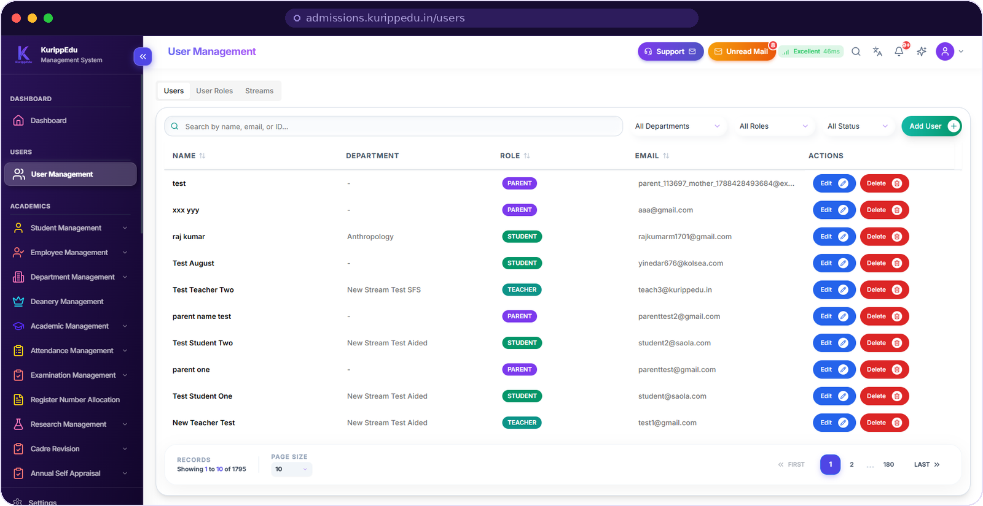


USER MANAGEMENT
One directory for everyone on campus.
Every role in one list
Students, teachers, parents, deans, IQAC reviewers and administrative staff share a single searchable directory.
Access follows the post
User roles and streams are configured centrally, so what a person can see and do is decided by their role, not by convention.
Parents are real users
Guardian logins are first-class accounts linked to the student record — not a shared password at the office.
Search by name, email or ID
Filter by department or role
Add and edit inline
Roles & streams tabs
9
Notes:
Start every product demo here: identity is the foundation everything else inherits.
The count in the corner (1,795 users in the demo) makes the point that this is a directory, not a handful of admin accounts.
If they ask about parent access, this is where you say it: parents get their own login, scoped to their own child.

Slide 10
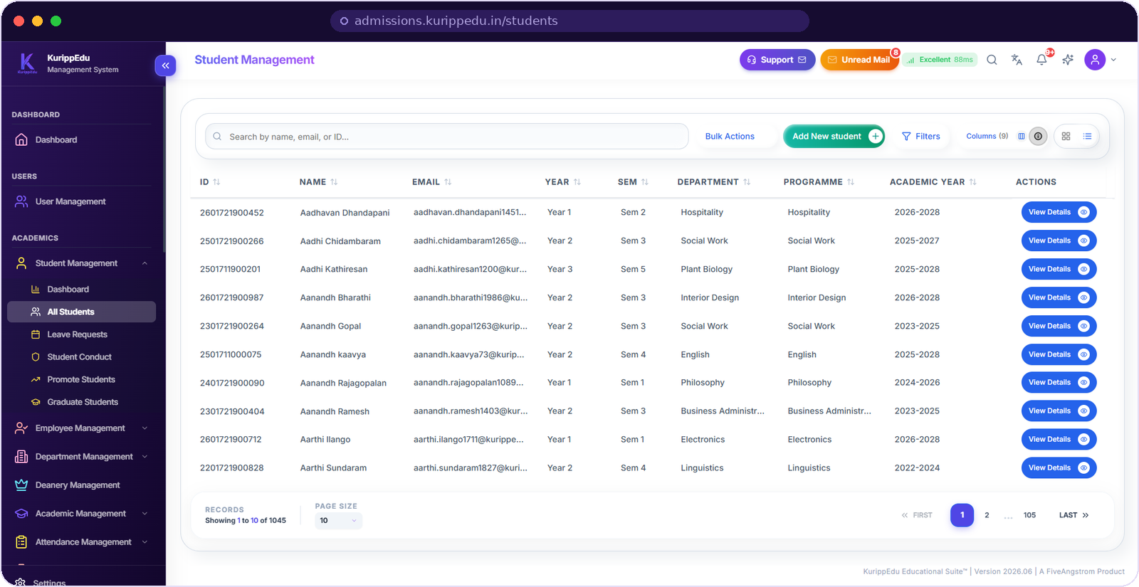



STUDENT MANAGEMENT
The whole student lifecycle on one record.
Admission to alumni
Register number, programme, department, year, semester and academic year travel with the student from entry to graduation.
Everything attaches here
Attendance, leave requests, conduct, promotion and graduation are actions on the same record — not separate registers.
Built for a real roll
Bulk actions, filters and a column chooser make a ten-thousand-student roll as workable as a class list.
Bulk actions
Nine configurable columns
Promote in batches
Graduate in batches
10
Notes:
Point at Promote Students and Graduate Students in the sidebar — the annual rollover that eats a week of office time is two screens here.
The register-number allocation module sits next to this one, so numbering rules are enforced rather than remembered.
Ask: "What happens today when a student changes programme mid-year?" Their answer usually sells this slide for you.

Slide 11

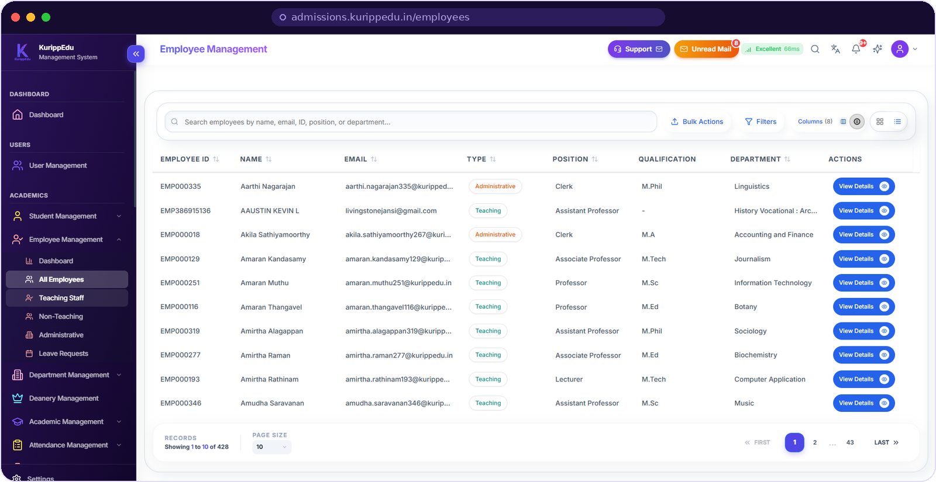


EMPLOYEE MANAGEMENT
Faculty and staff, in your own vocabulary.
Teaching, non-teaching, administrative
Each employee carries type, position, qualification and department, so the same list serves HR, academics and audit.
Cadre-aware from day one
Assistant Professor, Associate Professor, Professor, Lecturer and Clerk are structural fields — not free text someone typed.
Aided and self-financed
Funding type sits on the record, so sanctioned strength, cadre revision and reporting all compute correctly.
Leave requests
Bulk actions
Filter by type & position
Teaching-staff view
11
Notes:
This slide is for the office superintendent and the correspondent. Cadre and funding type are the two fields Indian colleges cannot live without.
Because those fields are structural, cadre revision and appraisal later in the deck need no re-entry.
Mention that non-teaching and administrative staff are in the same module — no second HR system.

Slide 12
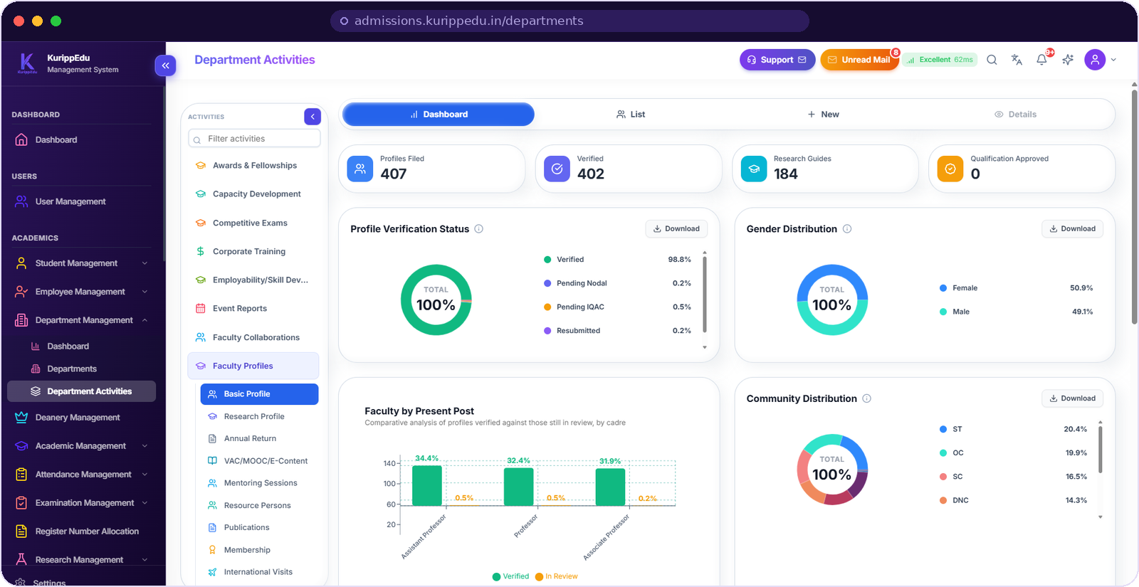
DEPARTMENT ACTIVITIES
Twenty registers your departments already keep — digitised.
Faculty profiles, verified
Basic, research and annual-return profiles move through nodal and IQAC verification, each with its own status.
Twenty activity registers
Awards and fellowships, capacity development, competitive exams, corporate training, MOOCs, mentoring, publications, memberships, international visits and more.
Analytics for free
Because entry is structured, cadre, gender and community distributions plot themselves — no separate compilation.
Profile verification workflow
Research guides tracked
Download any chart
Dashboard, list & details views
12
Notes:
HODs are the hardest group to win. The pitch to them is not reporting — it is that the register they already maintain by hand now produces its own analytics.
Name three or four of the twenty registers that match the college in front of you.
The verification chain (nodal, then IQAC) is what makes the data defensible in an audit.

Slide 13

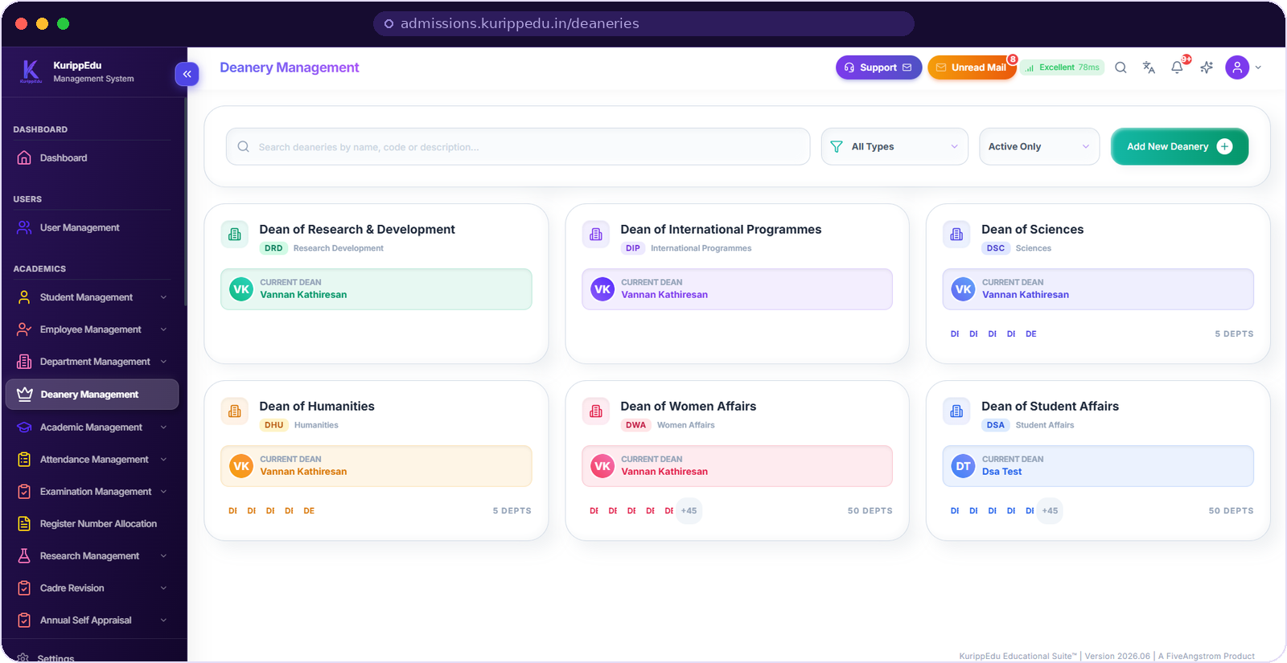


DEANERY MANAGEMENT
Governance modelled the way your college is run.
Deans as first-class entities
Research & Development, International Programmes, Sciences, Humanities, Women Affairs, Student Affairs — each with a code and a sitting dean.
Departments mapped to deaneries
A dean sees the departments in their charge and only those, so delegation is a setting rather than a promise.
Change without a rebuild
Create a deanery, reassign departments or hand over charge as ordinary operations — no vendor ticket required.
Custom deanery types
Active-only filter
Department counts on the card
Search by name or code
13
Notes:
Most ERPs stop at departments. Deaneries are why this one fits an autonomous or affiliated Indian college.
Tie it back to access control: deanery scope is what a dean's dashboard filters on.
Useful question: "Who signs off on research proposals in your college?" — then show that person their own view.

Slide 14
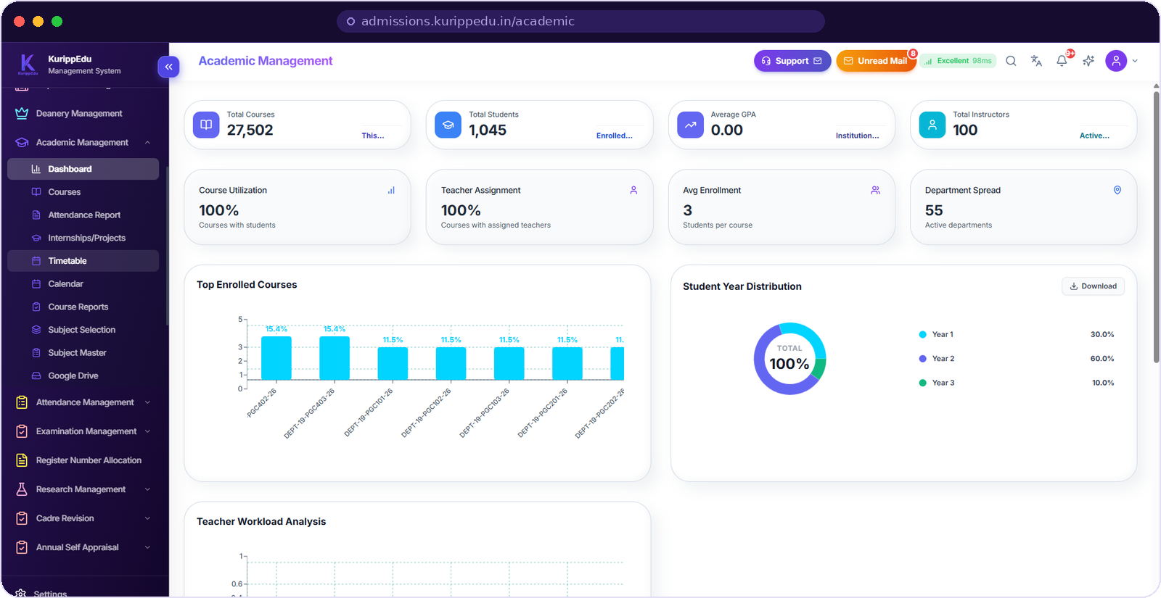


ACADEMIC MANAGEMENT
Courses, timetable and calendar in one place.
Catalogue with utilisation
Course utilisation, teacher assignment, average enrolment and department spread on one screen — before the term starts, not after.
Timetable and calendar
Published timetables flow straight to the student app. Nothing is retyped, and nothing is out of date by a week.
Material where it belongs
Google Drive integration keeps course material attached to the subject it teaches.
Subject master & selection
Attendance reports
Teacher workload analysis
Course reports
14
Notes:
The number to point at is course utilisation and teacher assignment — both at 100% in the demo, both computed, not declared.
Say the app line clearly: the timetable a coordinator publishes here is the timetable a student sees on their phone.
Teacher workload analysis is the slide-within-a-slide for a vice-principal balancing loads.

Slide 15
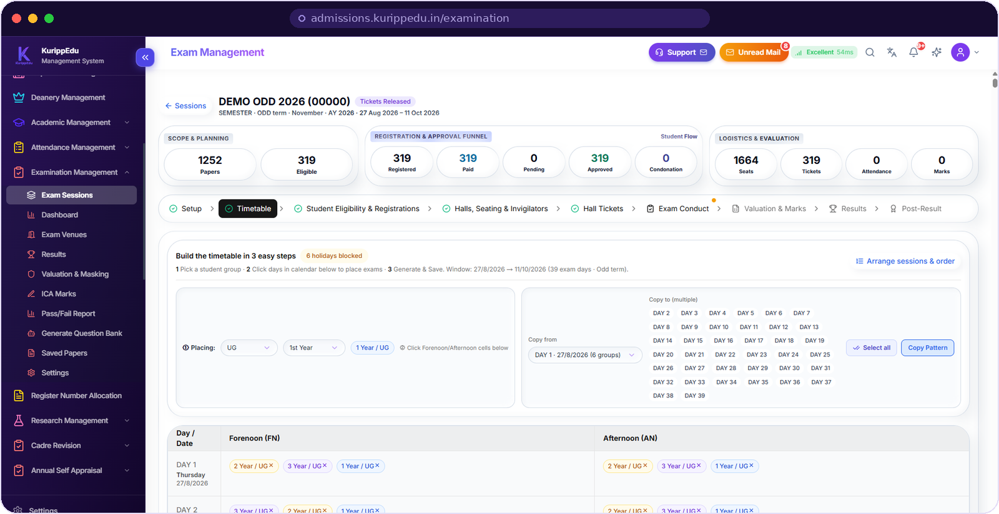


EXAMINATION MANAGEMENT
Examinations, end to end,
with nothing on paper.
One controlled pipeline
Nine stages from setup to post-result, each gated, each leaving a trail.
Registration to hall ticket
Eligibility, registration, payment, approval and condonation counted live on one funnel.
Valuation with masking
Dummy numbering, ICA marks, valuation and pass/fail reporting belong to the same session.
1
2
3
4
5
6
7
8
9
Setup
Timetable
Eligibility &
registration
Halls, seating
& invigilators
Hall tickets
Exam conduct
Valuation
& marks
Results
Post-result
Every stage is a screen with its own approvals — the controller of examinations can see exactly where a session stands.
15
Notes:
Slow down here. Examinations are the single biggest source of institutional risk and the strongest reason a college replaces its ERP.
Walk the nine chips left to right with a finger. Then point at the funnel on the screenshot: papers, eligible, registered, paid, pending, approved, condonation.
Masking and dummy numbering is the trust line for a controller of examinations — say it explicitly.

Slide 16
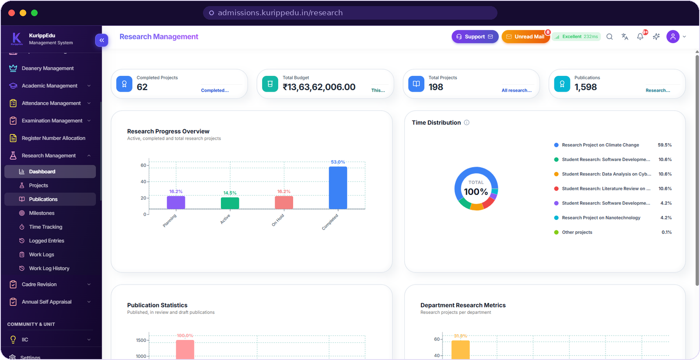

RESEARCH MANAGEMENT
Research, funding and publications on one ledger.
Projects with real states
Planning, active, on hold and completed — each with budget, milestones, a guide and a department.
Budget you can defend
Sanctioned budget rolls up across projects and departments, so a research dean answers funding questions from one screen.
Publications and IPR
Publication statistics, department-wise output, and patents filed, granted or published — the exact fields NIRF asks for.
Milestones
Time tracking & work logs
Department research metrics
Publication statistics
16
Notes:
This is the slide for the dean of research and for any college chasing an autonomous or NIRF-ranked profile.
Note that the IPR ring on the main dashboard is fed from here — one entry, two audiences.
Work logs and time tracking matter for funded projects with utilisation certificates.

Slide 17
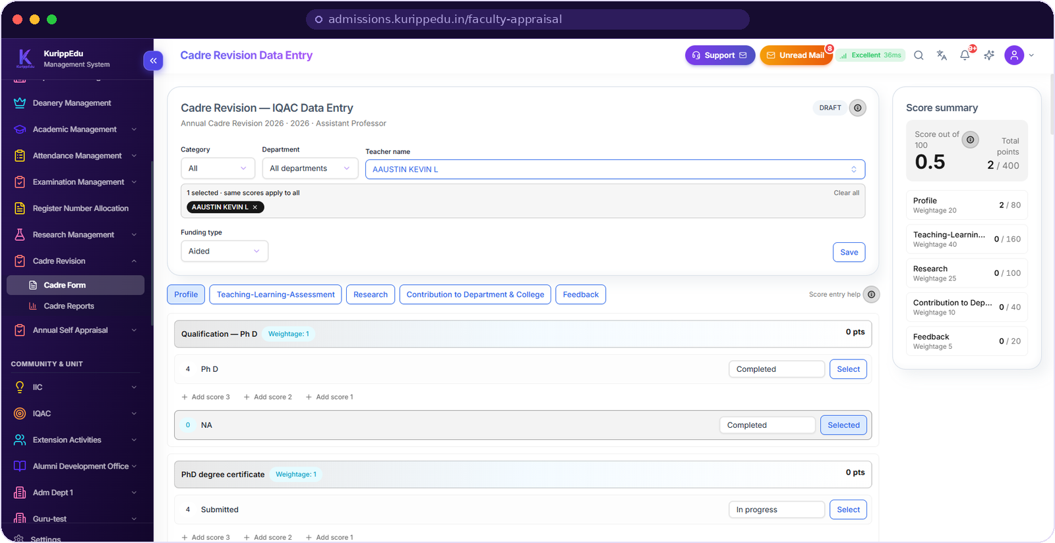

CADRE REVISION
Scoring rules, applied the same way every time.
Weighted and transparent
Profile 20, teaching-learning 40, research 25, contribution 10, feedback 5 — four hundred points normalised to a score out of a hundred.
Every point has evidence
Scores attach to a qualification, a certificate or an activity that already exists in the system.
One form, many teachers
Apply a common set of scores to a selected group, filtered by category, department and funding type.
Draft → review → approve
Category & funding filters
Live score summary
Cadre reports
17
Notes:
Cadre revision is where colleges lose weeks and trust. The pitch is consistency: the same rule applied to every teacher, visible while it is applied.
Point at the score summary panel updating on the right as entry happens.
Say the word "draft" — nothing is final until IQAC review, which protects both the faculty and the office.

Slide 18
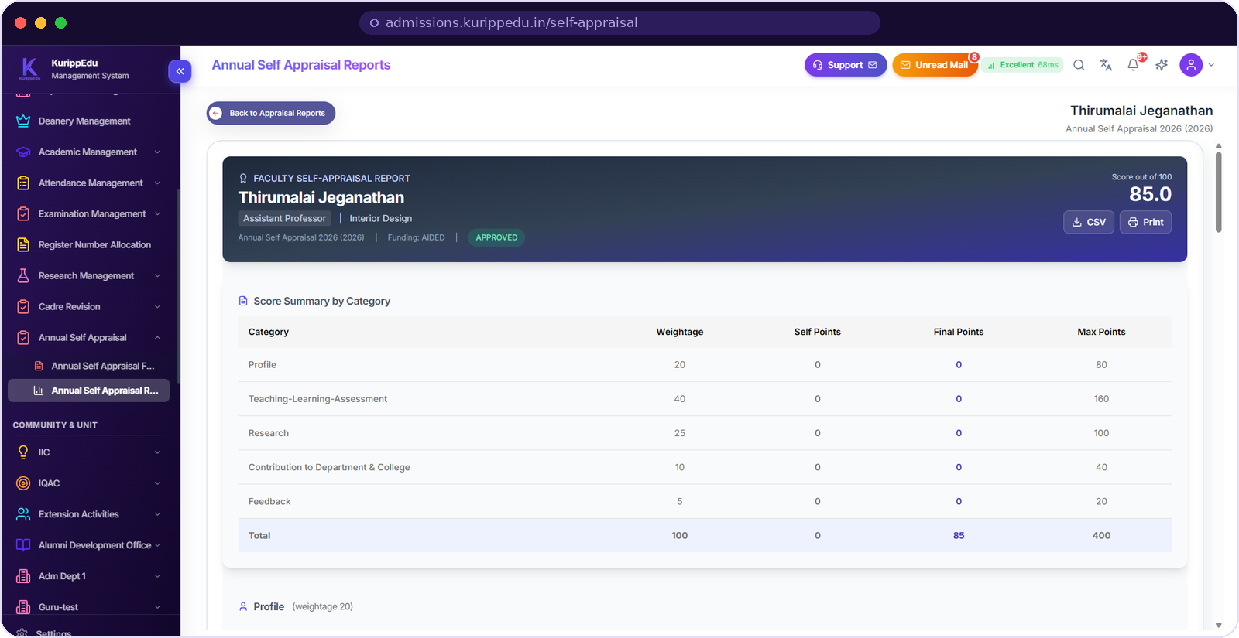

ANNUAL SELF APPRAISAL
Appraisals that close in days, not months.
Faculty fill it once
Self points against the same five categories, with the maximum for each visible while they type.
Reviewed, then final
Self points and final points sit side by side, and approval is a state on the record rather than an email in a folder.
A report at the end of it
Score summary by category, ready to print for the file or export as CSV for the management review.
Approved / draft states
Score out of 100
CSV export
Print-ready report
18
Notes:
Pair this with the previous slide — same five categories, same weightages, two different processes.
The example on screen shows 85 out of 100, approved. Walk from the header down to the category table.
For a principal, the value is the audit trail: who scored what, when, and on what evidence.

Slide 19
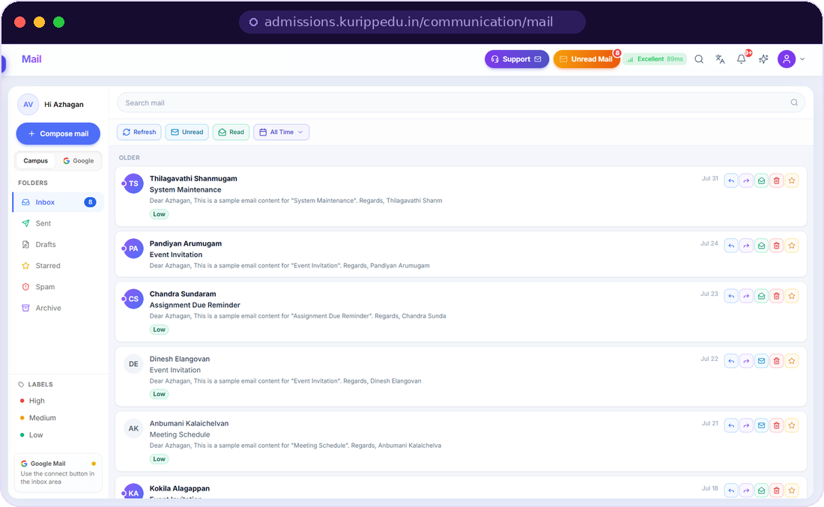
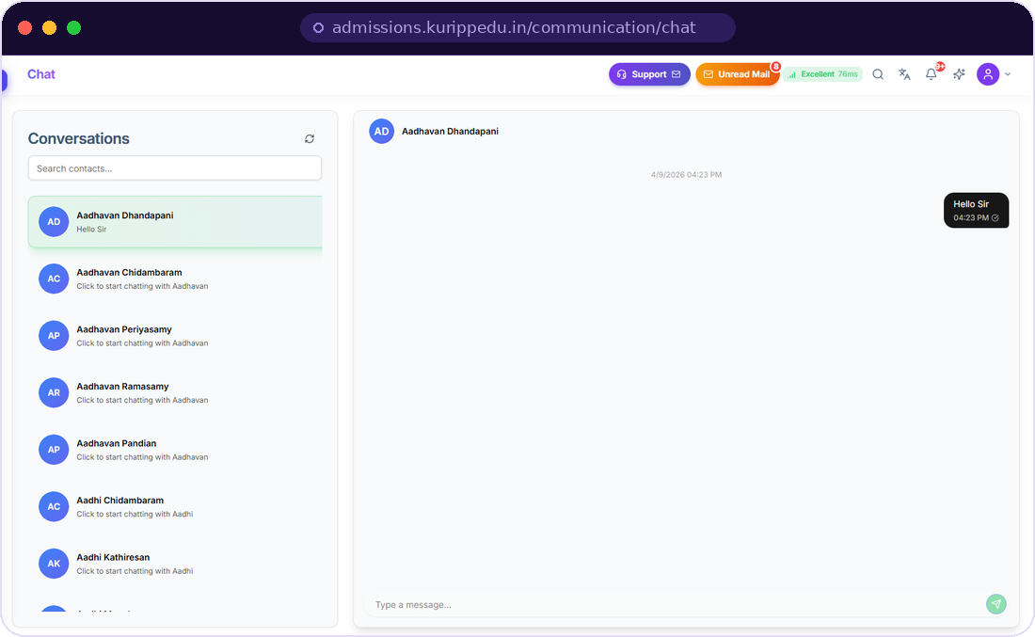
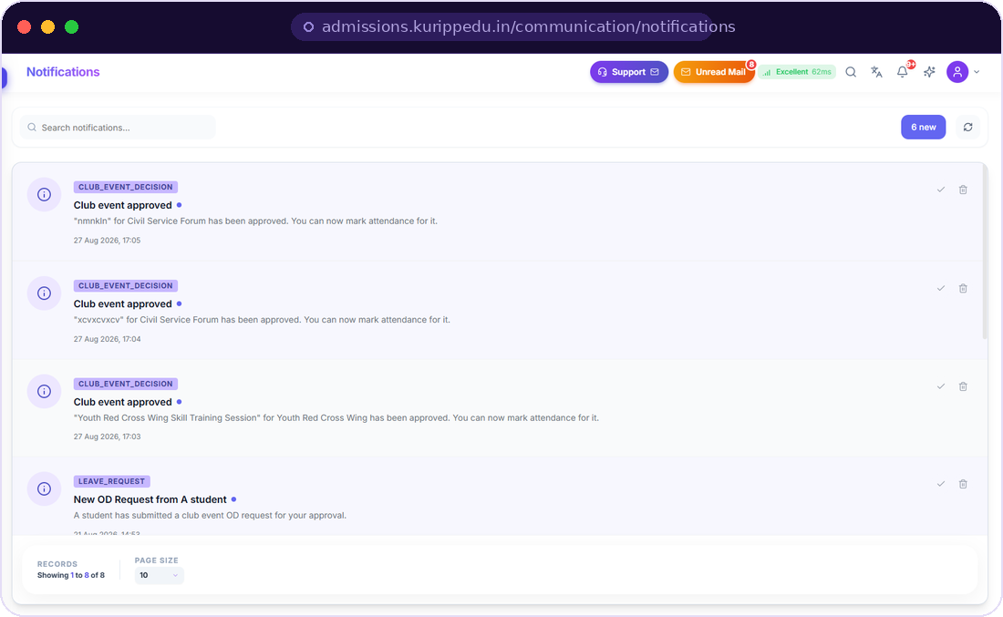


COMMUNICATION
The conversation lives inside the ERP.
No side channel, no lost approval, no screenshot forwarded to a personal number.
Campus mail
Direct chat
Notifications
Threaded inbox with priority labels, folders and starred items — plus Google Mail connect for external accounts.
Any two people in the directory, on the same screen they already work in. No external app to police.
Club event decisions, OD and leave requests, system alerts — each one actionable, each one logged.
Announcements broadcast to a role, a department or the whole campus from the same module.
19
Notes:
The objection this pre-empts: "we already use WhatsApp". Answer: WhatsApp has no record, no role scope and no approval state.
Notifications are the interesting one — a leave request or club event approval is a decision captured in the system, not a message someone remembers.
Announcements let the office reach one role, one department or the whole campus without maintaining phone lists.

Slide 20
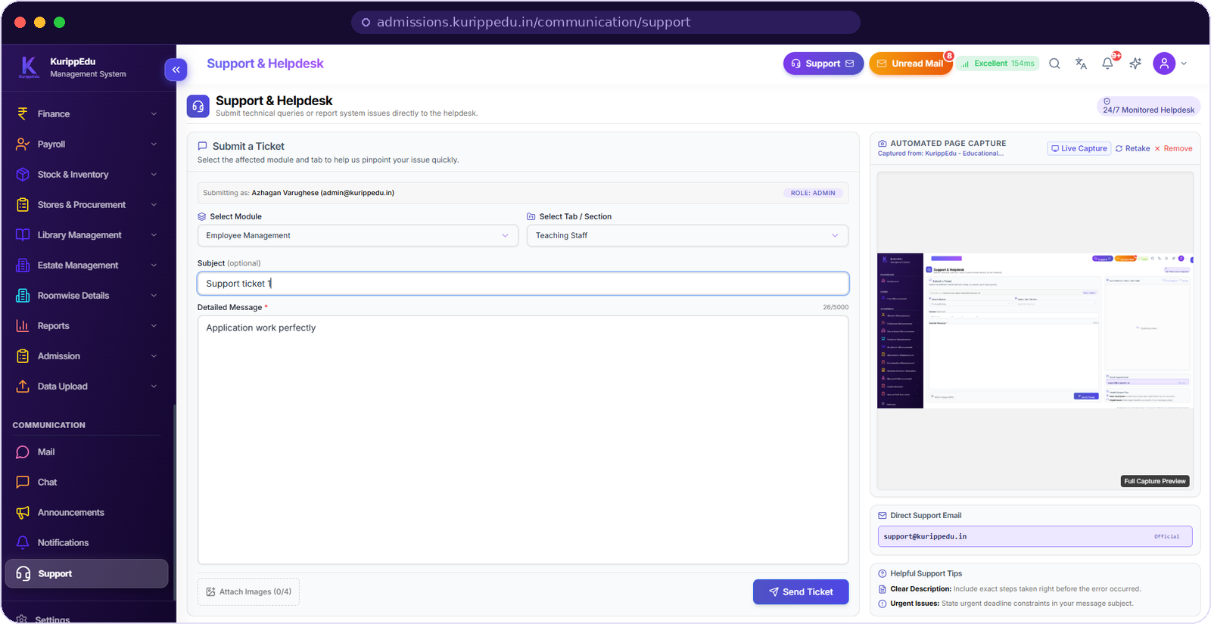



SUPPORT & HELPDESK
A ticket that already knows where it came from.
Raised from the screen in question
Module and tab are pre-selected, and the person and their role are attached automatically.
Automated page capture
The page is captured with the ticket, so support sees exactly what the user saw — no "can you send a screenshot?".
Monitored around the clock
A direct line to support@kurippedu.in for anything the in-app route cannot carry.
Up to four attachments
Live capture & retake
Role shown on submit
24/7 monitored desk
20
Notes:
Procurement committees ask about support before they ask about features. Show this slide unprompted.
Automated page capture is the differentiator — it removes the slowest step in every support conversation.
Have a real answer ready on response times and escalation for the customer in front of you.

Slide 21
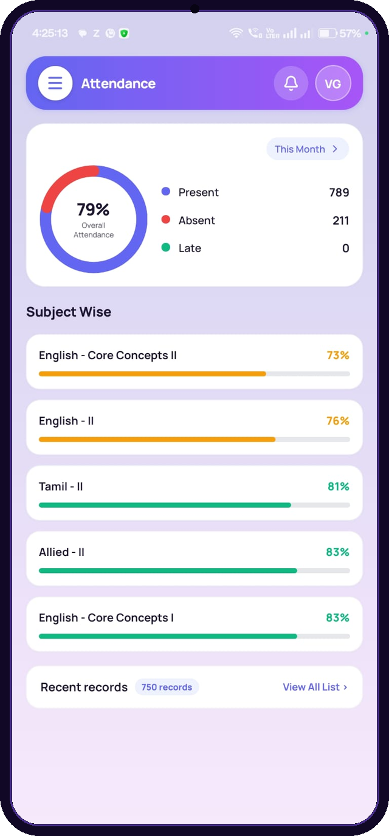

STUDENT & PARENT APP
Timetable, attendance and fees —
in their pocket, not your counter.
Today, at a glance
Published classes for the day — or a clear “nothing scheduled” instead of a guess.
Attendance they can't dispute
Overall percentage plus subject-wise bars, read from the same attendance module the faculty marks.
Fees without the queue
Current due, next due date, invoices, payments and financial records — self-served.
Quick access: attendance · timetable · academics · results · convocation · exams · fees
Notes:
Parents are the quiet decision-makers in a private college. This screen is what they experience.
Say the arithmetic out loud: every self-served fee query is a phone call the office does not take.
The attendance number here is the same number the faculty marked — no reconciliation, no dispute.

Slide 22







BEYOND ACADEMICS
The back office runs on the same spine.
Finance and stores are not a separate purchase, and not a separate login.
Finance
Payroll
Stock & inventory
Stores & procurement
Fee heads, income and financial records tied to the student ledger.
Staff pay processed against the same employee master.
Assets and consumables tracked by department.
Indents and purchases with an approval path.
Library
Estate & rooms
Admissions
Data upload & reports
Catalogue and circulation against real student identities.
Estate management with roomwise details for allocation.
Applications through to enrolled student records.
Bulk migration in, standard reports out.
Also included · IIC · Extension activities · Alumni development office · Roomwise details · Standard reports
22
Notes:
Use this slide to close the "we would still need another system for X" objection.
The link that matters: finance reads the same student master, payroll the same employee master, library the same identities.
Do not demo all eight. Ask which one hurts most today and open just that.

Slide 23



WHY IT HOLDS UP
Fast, role-bound and auditable.
Measured in milliseconds
Role-bound by design
One database, always audited
Every screen reports its own response time in the header. Across the screens in this deck the demonstration instance answered between 36 and 232 ms.
Roles, streams and deanery scope decide what loads — access is a property of the account, not something hidden in the interface.
Draft, submitted, verified and approved are states on the record, each carrying who acted and when.
ISO 27001 certified cloud
DPDP Act 2023 compliant
Versioned releases
Nothing to install — a browser and the Android app.
Built for institutions holding sensitive student data.
Version 2026.06 today, with updates for every customer.
Response figures are the in-app measurements visible on the screenshots in this deck, not a benchmark claim.
23
Notes:
This is the IT-committee slide. Three claims, all of them visible on the product rather than asserted on a slide.
Be precise about the millisecond figures: they are the numbers printed in the header of the very screenshots you just showed. Do not inflate them into a performance guarantee.
If they ask about hosting, data location or backups, answer from your own deployment facts — not from this slide.

Slide 24





GETTING LIVE
Five steps from purchase order to full campus use.
1
2
3
4
5
Discovery
Data migration
Configuration
Training
Go-live & support
We map your departments, deaneries, programmes, cadres and the registers you keep today.
Existing student, staff and course data is bulk-uploaded and reconciled with your office.
Roles, streams, scoring weightages, exam patterns and fee heads set to your own regulations.
Role-wise sessions for office staff, faculty, HODs, the exam cell and the IQAC team.
Phased switch-on, then a monitored helpdesk and versioned updates.
Timelines depend on how ready your existing data is — that is the first thing we scope in the discovery call, before any commitment.
24
Notes:
Buyers fear implementation more than price. Five steps, named, in order, is the whole point of this slide.
Do not promise a number of weeks in the room. Promise a scoped plan out of discovery.
Emphasise role-wise training: the exam cell and the IQAC team need different sessions from the office staff.

Slide 25


WHY KURIPPEDU
Built inside a college, not for a demo.
Your vocabulary, not a translation
Everything included
One vendor, one roadmap
Cadre, aided and self-financed, deanery, IQAC, NIRF, condonation, ICA, register number allocation — the system already speaks it, because it was built for it.
46+ modules ship together. There is no module-by-module upsell standing between you and a working campus.
A single team behind the whole suite, versioned releases, in-app support and answers in your own time zone.
Built for
Arts & science colleges
Autonomous colleges
Universities
Engineering & polytechnic
Multi-campus groups
KurippEdu Educational Suite™ · Version 2026.06 · A FiveAngstrom Product
25
Notes:
The first card is the real differentiator against an international ERP: nobody has to translate their process into someone else's model.
The second kills the pricing-page objection. The third answers "who do I call when it breaks".
Point at the institution type that matches the room and say it out loud.

Slide 26
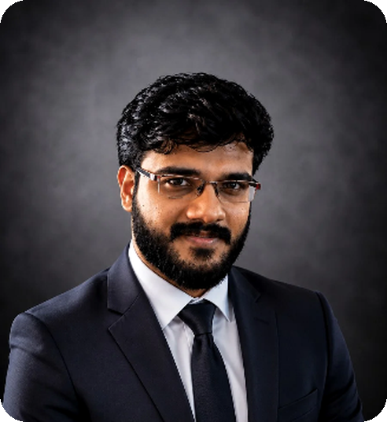
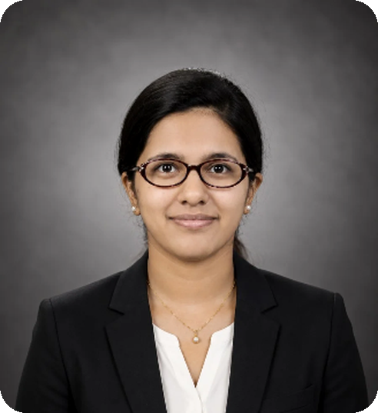
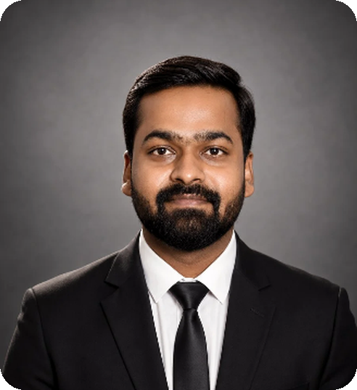
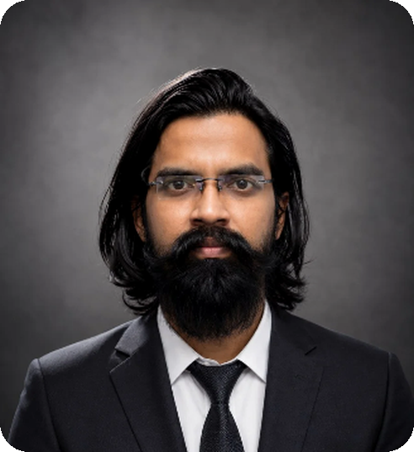
LEADERSHIP
The minds driving educational intelligence.
A physicist-led founding team spanning deep-tech research, institutional operations, market and quality, and engineering.
B. Rishab Antosh
Dr. A. Roslin Elsa Varughese
Charles Amaldass
E. Mohandoss
Chief Executive Officer
Chief Operating Officer
Chief Marketing Officer & Quality Head
Team Lead — Engineering & Infrastructure
CORE FOCUS
CORE FOCUS
CORE FOCUS
CORE FOCUS
AI & ML architecture · LLM systems · Product innovation · Strategic growth
Operations · Cybersecurity · Data privacy · Institutional governance
Institutional sales · Marketing & outreach · End-to-end QA · Market strategy
Linux systems · Infrastructure · Front-end engineering · Deployment
INSTITUTIONAL BACKING
DPDP Act 2023 compliant
ISO 27001 certified cloud
Incubated at CIRI, MCC–MRF Innovation Park
Madras Christian College, Chennai — deep-tech R&D and institutional delivery
NAAC & NBA alignment
Dedicated SLA & on-site support
Technology & compliance partnerships · AWS Technology Partner · Sarvam AI · DSCI Corporate Member
26
Notes:
Use this slide when the room asks "who are you?" — usually right before pricing, and always with a government or aided institution.
The two-physicist point is worth saying out loud: the research depth is unusual for an ERP vendor, and it explains the AI roadmap.
CIRI at Madras Christian College does more work than any credential on the slide — an incubated product inside a college campus answers the "do you understand our world?" question before it is asked.
Have the compliance items ready to defend: DPDP Act 2023, ISO 27001 on the cloud, NAAC and NBA alignment, and what exactly the SLA covers.

Slide 27





Educational Suite™
Let's put your campus
on one platform.
A thirty-minute walkthrough, then a sandbox loaded with your own departments and data. You decide after you have used it, not after you have watched it.
Book the walkthrough
Sandbox with your data
Phased go-live plan
kurippedu.in
+91 73057 52333
sales@kurippedu.in
Mon–Sat, 9:00 AM – 7:00 PM
CIRI, MCC–MRF Innovation Park · Madras Christian College, Chennai 600059
KurippEdu Educational Suite™ · Version 2026.06 · A FiveAngstrom Product
Notes:
Close on the offer, not on the product: a walkthrough and then a sandbox with their own data.
Ask for one specific next action before you leave the room — a date for the walkthrough and the name of the person who owns their data.
Leave the deck itself with them; every screenshot is real and the speaker notes carry the talk track.

